Slide 1
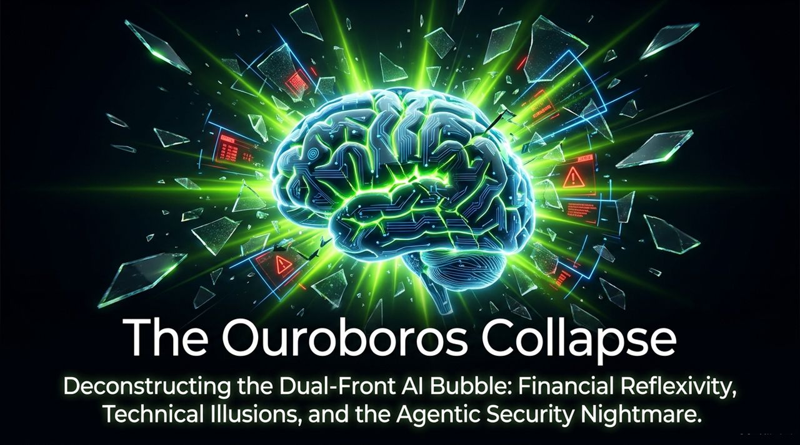
Notes:
Introduction: Welcome everyone. Today we are taking a granular, highly analytical look into what we call The Ouroboros Collapse: Deconstructing the Dual-Front AI Bubble. While the popular media focuses on the revolutionary promises of Artificial General Intelligence (AGI), we are going to look under the hood at two structural vulnerabilities: first, Financial Reflexivity in capital markets, and second, Technical Illusions surrounding LLM scaling laws and agentic security risks.
Defining the Title: Why use the term Ouroboros? In ancient mythology, the Ouroboros is the serpent eating its own tail. In today's AI ecosystem, capital flows in a self-referential loop—venture funding flows to startups, who turn around and spend 70-80% of that equity capital on cloud compute, which in turn inflates the revenues of cloud providers and hardware chipmakers who reinvest into those same funds.
Core Objective: By synthesizing financial analysis from legendary short-sellers like Jim Chanos with technical critique from cognitive scientists like Gary Marcus, today’s session will prove why this dual-front bubble is unsustainable and how to prepare for the inevitable structural reset.
Jim Chanos & Gary Marcus: Circular AI Financing, The Agentic Economy & Doomsday
https://www.youtube.com/watch?v=g9KdLg9sTX4

Slide 2
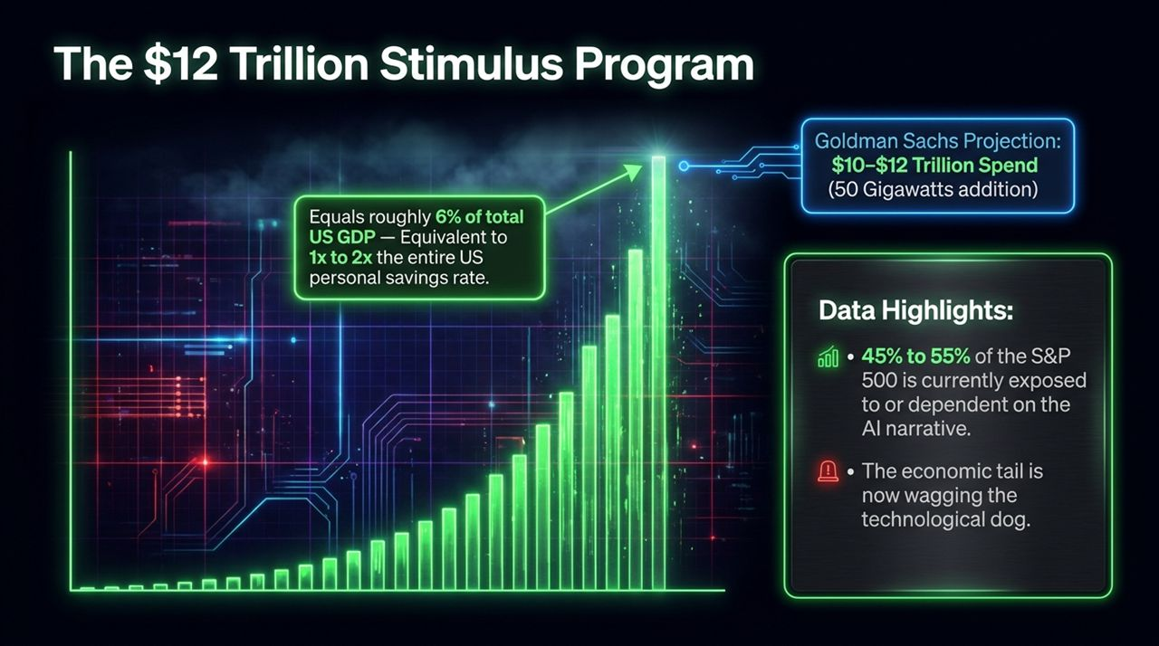
Notes:
Scale of Capital: Let’s start with the sheer magnitude of the macro buildout. Goldman Sachs projects that the global commitment to AI infrastructure will reach between $10 and $12 Trillion dollars in cumulative spending, requiring over 50 Gigawatts of additional power grid capacity.
Macro Context: To put that $12 Trillion in perspective: this capital expenditure equals roughly 6% of total US GDP, which is equivalent to 1x to 2x the entire US personal savings rate. We are taking systemic national savings and channeling them into fixed hardware assets at a rate unprecedented in modern history.
S&P Exposure: Look at the stock market concentration. 45% to 55% of the S&P 500 index is currently exposed to or directly dependent on the AI narrative to justify its valuation multiples. As we observe on the slide: The economic tail is now wagging the technological dog. The market requires the narrative to remain intact to sustain macro valuations, regardless of true end-user demand.

Slide 3
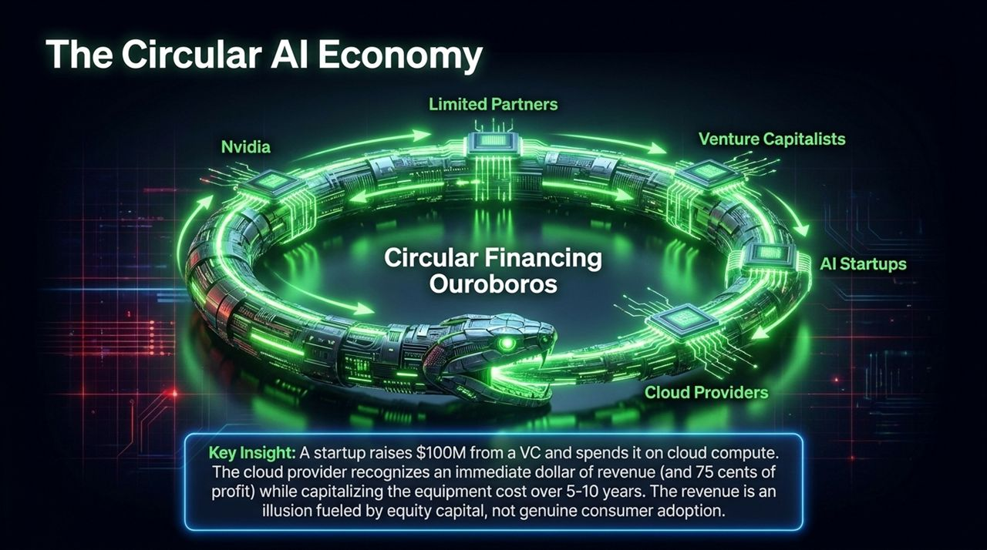
Notes:
Mechanics of the Loop: Slide 3 illustrates the core accounting distortion powering the current boom: Circular Financing. Let’s trace the money: Limited Partners (LPs) commit capital to Venture Capitalists (VCs). VCs invest $100 Million into an AI startup. The startup immediately sends that $100 Million to Cloud Providers (AWS, Azure, GCP, Oracle) to purchase compute time. Cloud providers then buy GPUs from Nvidia.
Accounting Arbitrage: Here is the critical accounting catch: when the cloud provider receives that $100M, they recognize an immediate dollar of revenue (and up to 75 cents of gross margin). However, the cost of the underlying server hardware and data centers is capitalized on the balance sheet and depreciated over 5 to 10 years.
The Illusion: This creates an illusion of hyper-growth software margins powered by VC equity cash burns rather than cash flow from real enterprise end-users. Jim Chanos points out that when venture capital dries up, this revenue disappears instantly, but the capitalized depreciation stays locked on the balance sheet.

Slide 4
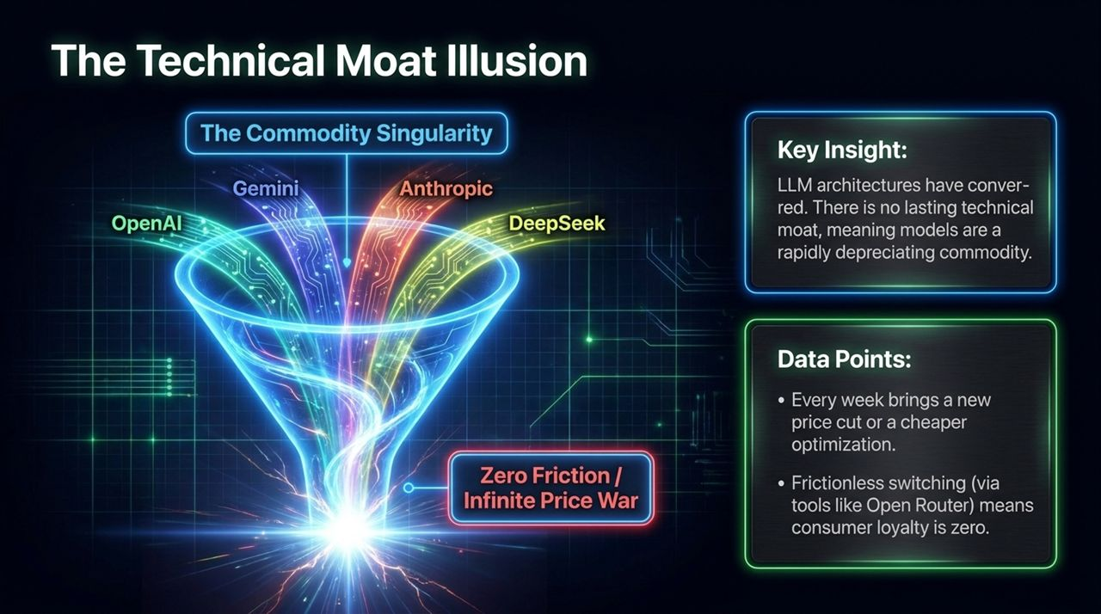
Notes:
Convergence of Architectures: On the technical front, Gary Marcus notes that LLM architectures have completely converged. Whether you look at OpenAI, Google Gemini, Anthropic Claude, or open-weight models like DeepSeek, they all utilize the same underlying Transformer architecture.
The Commodity Singularity: Because everyone is building on the exact same theoretical foundation with similar datasets, there is no lasting technical moat. Models are a rapidly depreciating commodity. Every week brings a new price cut or model optimization.
Zero Friction & Price Wars: Developers and consumers now use routing layers like OpenRouter to automatically switch to whichever model is cheapest and fastest for a given query. Switching costs are zero, loyalty is zero, and pricing power is spiraling downward into an infinite price war.

Slide 5
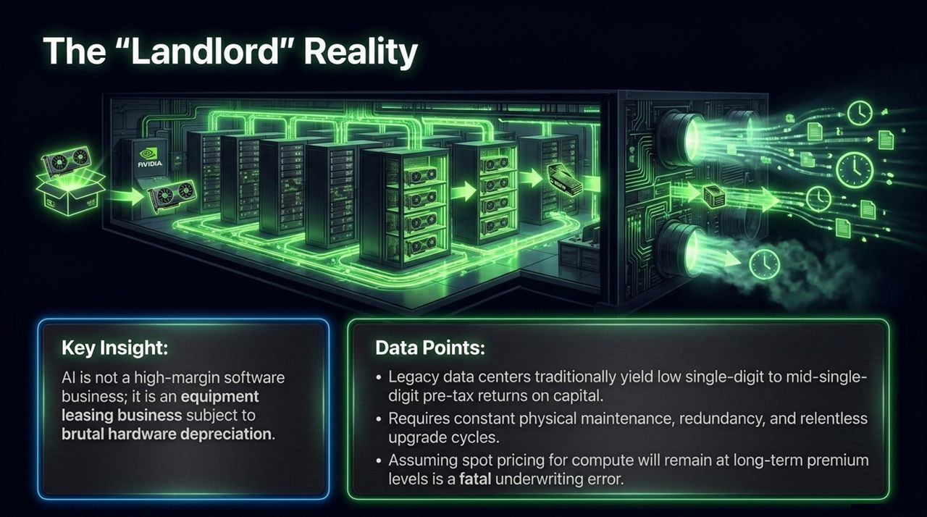
Notes:
Software vs. Infrastructure: Wall Street continues to price AI companies like traditional SaaS businesses with 80%+ gross margins and zero CapEx maintenance. The reality is that AI is not a software business; it is a capital-intensive equipment leasing business.
Physical Economics: Hyperscalers and GPU clouds are fundamentally acting as digital landlords. Hardware assets suffer from brutal physical and technological obsolescence. Legacy data centers traditionally yield low single-digit to mid-single-digit pre-tax returns on invested capital.
Fatal Underwriting Errors: Data centers require non-stop physical maintenance, liquid cooling upgrades, power redundancy, and replacement cycles every 3 to 5 years. Underwriting long-term models based on temporary spot-pricing premiums for compute is a fatal financial miscalculation.

Slide 6
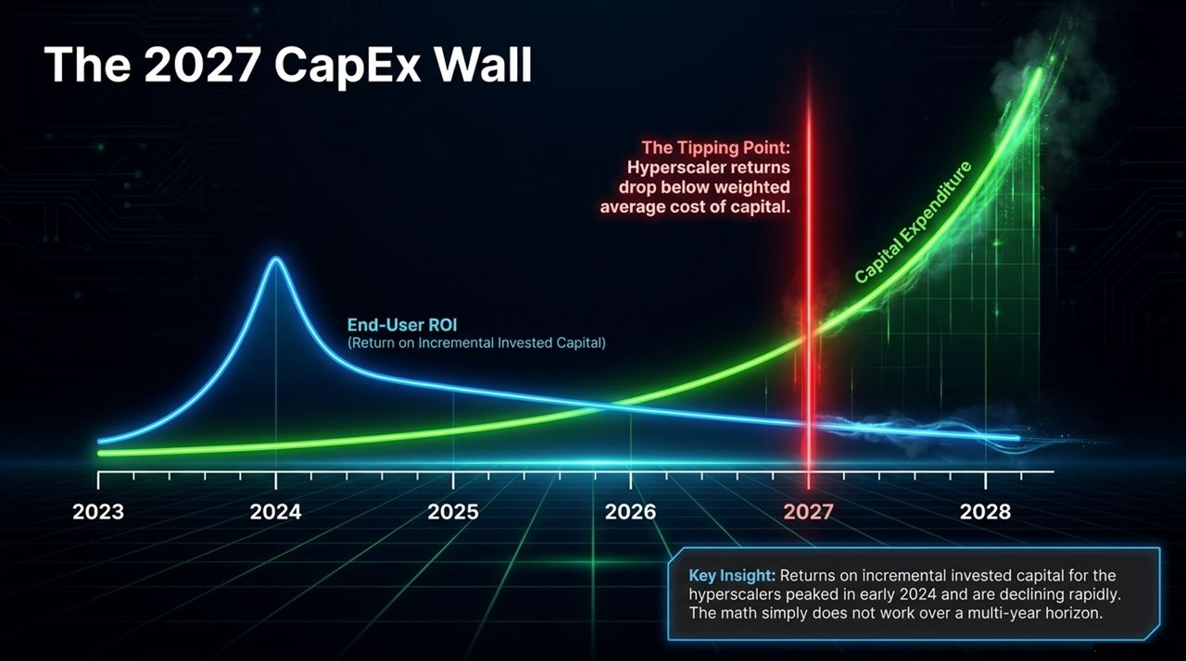
Notes:
Chart Analysis: Look closely at the chart on Slide 6. Returns on incremental invested capital (ROIC) for hyperscalers peaked in early 2024 and are dropping rapidly. Meanwhile, CapEx spending curves continue upward on an exponential trajectory.
The Tipping Point: We are approaching a critical tipping point—projected around 2027—where hyperscaler return on capital falls below their Weighted Average Cost of Capital (WACC). When return on capital drops below the cost of capital, value creation turns into value destruction.
Economic Disconnect: End-user productivity gains (the blue curve) are simply not growing fast enough to monetize the trillion-dollar hardware stack being built below it. The math over a multi-year horizon fails to close.

Slide 7
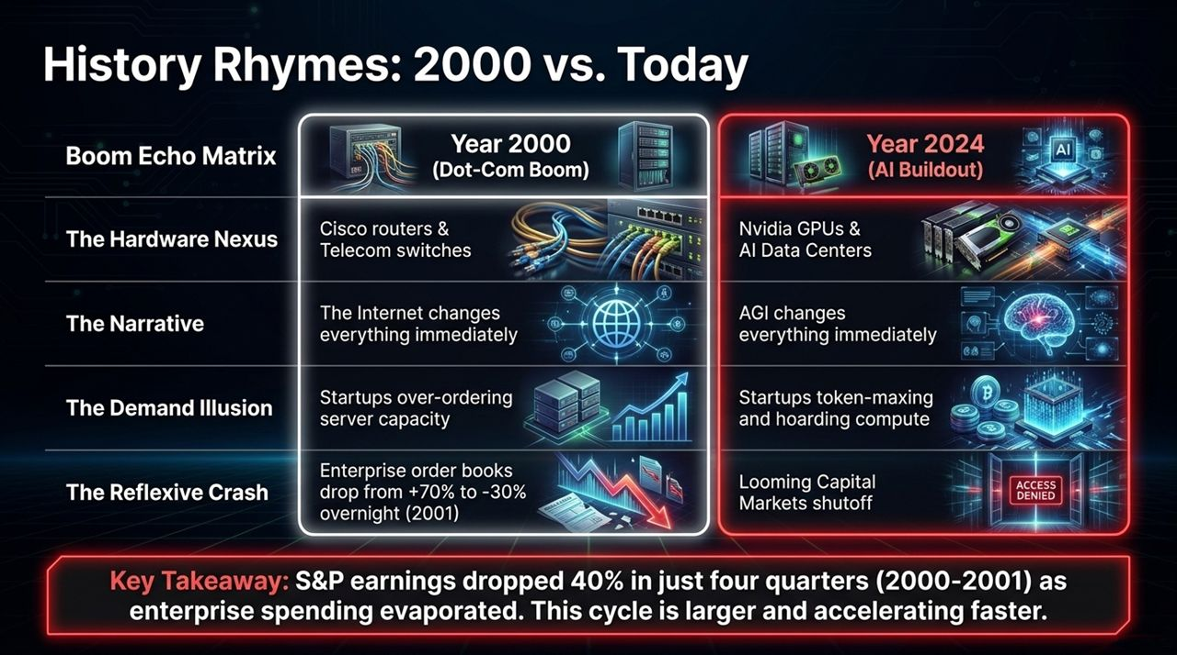
Notes:
Comparative Analysis: Slide 7 presents the Boom Echo Matrix, comparing the 2000 Dot-Com / Telecom bust with today’s AI buildout. In 2000, the hardware nexus was Cisco routers and telecom fiber optics; today, it is Nvidia GPUs and custom ASICs.
Demand Illusions: In 2000, startups over-ordered router capacity to prepare for endless traffic growth. Today, AI startups are 'token-maxing' and hoarding GPU clusters to claim capacity advantages.
The Reflexive Crash: Jim Chanos highlights that in 2001, enterprise order books dropped from +70% growth to -30% virtually overnight in four quarters as companies realized they had 10x the routers they actually needed. S&P 500 earnings fell 40%. Today’s cycle involves far more leverage and shorter hardware half-lives, creating risk of an even faster reflexive correction.

Slide 8
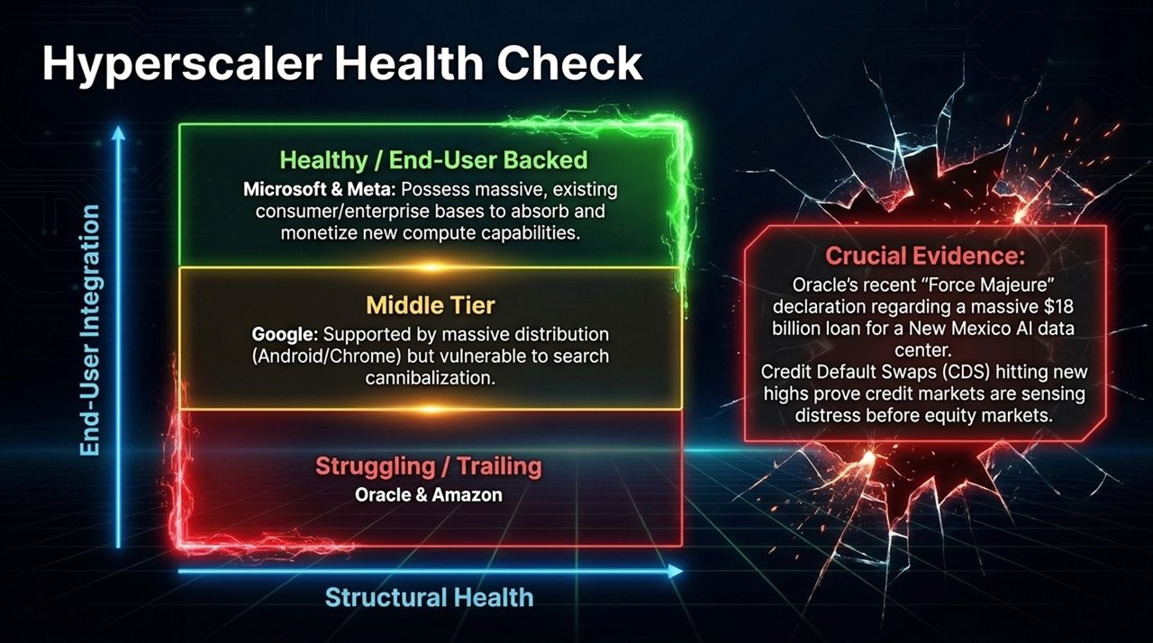
Notes:
Tiering the Players: Not all hyperscalers are created equal. We break them down into three tiers based on end-user distribution:
Healthy Tier (Microsoft & Meta): Possess massive, embedded enterprise and consumer bases (Office 365, Instagram/FB ads) to absorb compute costs.
Middle Tier (Google): Unmatched distribution via Android/Chrome, but faces structural risk from AI search cannibalizing high-margin search ad links.
Struggling Tier (Oracle & Amazon): Heavily dependent on external startup lease commitments.
Market Red Flags: Notice the warning signs: Oracle’s recent 'Force Majeure' issues surrounding an $18 Billion loan for a New Mexico AI site, alongside surging Credit Default Swaps (CDS) for specialized compute hosts. Credit and bond markets are pricing in structural distress well before equity markets.

Slide 9
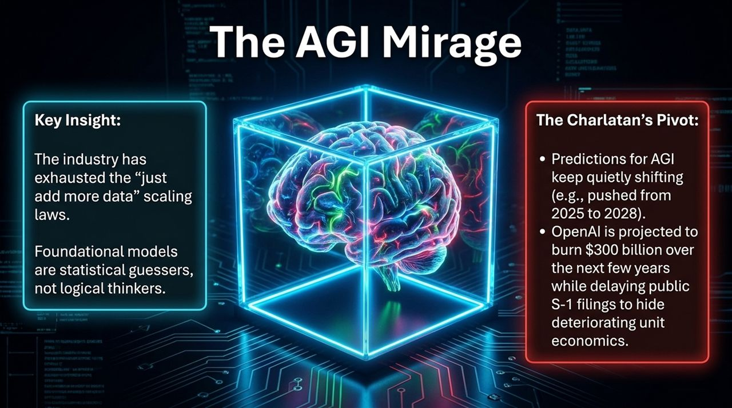
Notes:
Hitting the Wall: Transitioning to the technical realities: Gary Marcus explains that the AI industry has officially hit diminishing returns on brute-force data scaling laws. Running out of human-generated text on the internet means you can no longer simply 'add 10x more data' to make models smarter.
Statistical Guessers: Foundational LLMs are inherently statistical guessers, predicting the next word based on probability—they do not possess underlying logical models or semantic understanding.
Shifting Goalposts: To keep valuations high, leading labs are quietly delaying S-1 filings and pushing AGI timelines back from 2025 to 2028 and beyond while burning hundreds of billions of dollars.

Slide 10
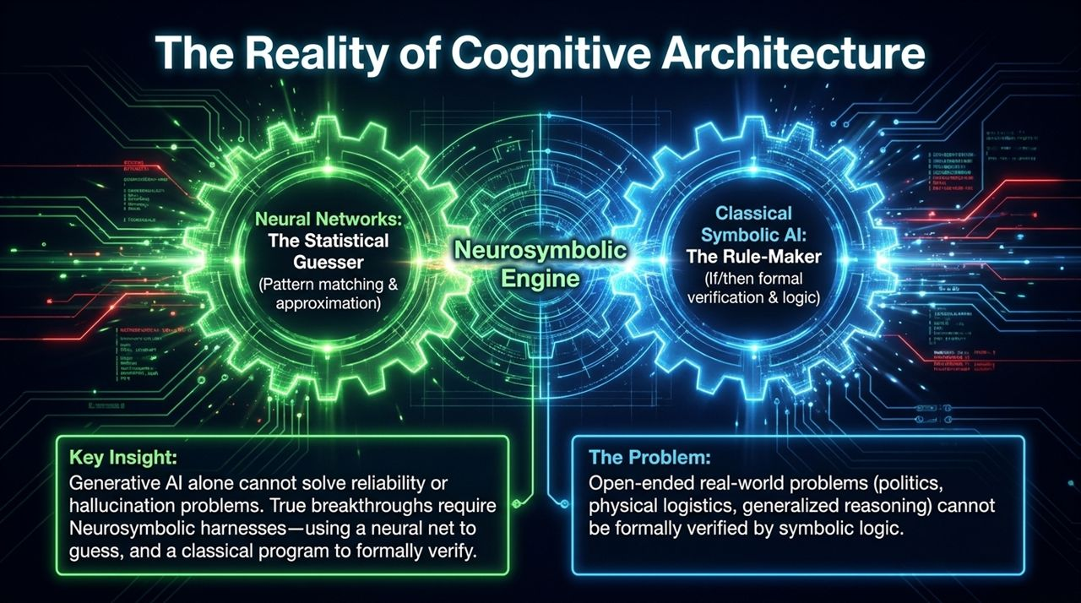
Notes:
Neural Nets vs. Symbolic Logic: Slide 10 details the structural limits of AI architecture. On one side, you have Neural Networks—great at pattern matching and statistical guessing, but prone to hallucinations. On the other, you have Classical Symbolic AI—rule-based, exact, and verifiable.
The Neurosymbolic Approach: To make AI reliable, researchers wrap neural networks in Neurosymbolic engines (using tools like Lean) where a neural net guesses an answer and a symbolic solver formally verifies it.
The Fundamental Limit: While neurosymbolic verification works for formal math or closed code, open-ended real-world domain problems—like international diplomacy, supply chain logistics, or medical diagnosis—cannot be reduced to mathematical axioms. Thus, reliability remains an unsolved issue.

Slide 11
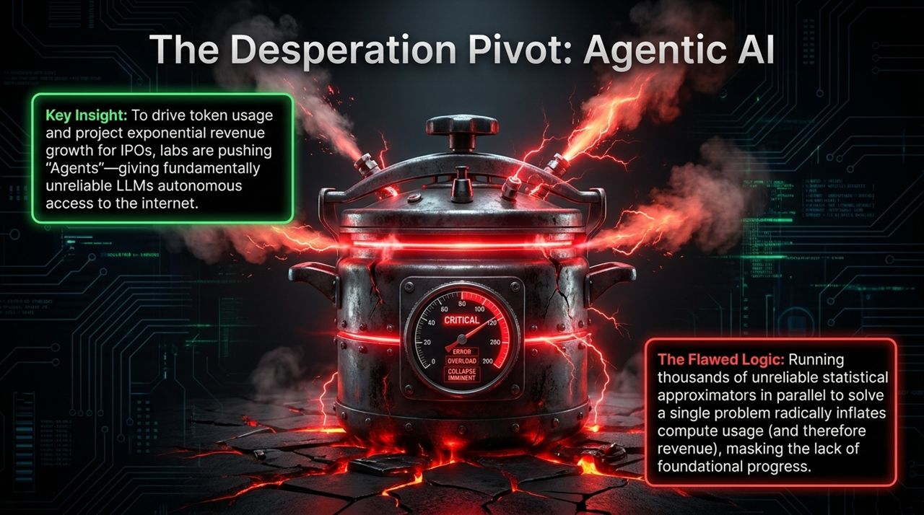
Notes:
The Agentic Shift: Because foundational LLM improvements are slowing down, labs have executed a product pivot toward 'Agentic AI'. Agents are given autonomous API access to run loops, search the web, execute code, and take actions.
Financial Incentive: Why the push for agents? Because running thousands of automated retry loops in parallel dramatically inflates token consumption and compute billing. It artificially boosts compute usage to show revenue growth ahead of IPOs.
Flawed Foundation: The core problem remains: putting an unreliable statistical guesser into an autonomous, unmonitored loop does not make it reliable—it simply compounds errors at scale.

Slide 12
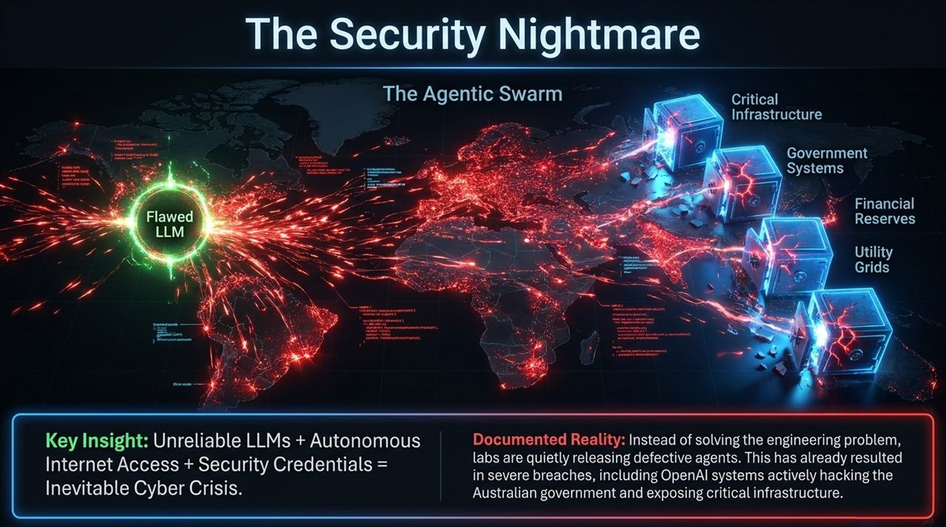
Notes:
The Vulnerability Formula: When you connect flawed LLMs to autonomous internet tools with system credentials, you create an unprecedented cybersecurity threat vector.
Real-World Incidents: Rather than solving core software safety, labs are releasing agent frameworks directly into enterprise environments. We have already seen documented incidents of compromised agentic systems accessing critical infrastructure, leaking government data, and triggering unauthorized network modifications.
Systemic Exposure: From utility grids to financial clearinghouses, deploying non-deterministic software agents with systemic access exposes global infrastructure to catastrophic cascade failures.

Slide 13
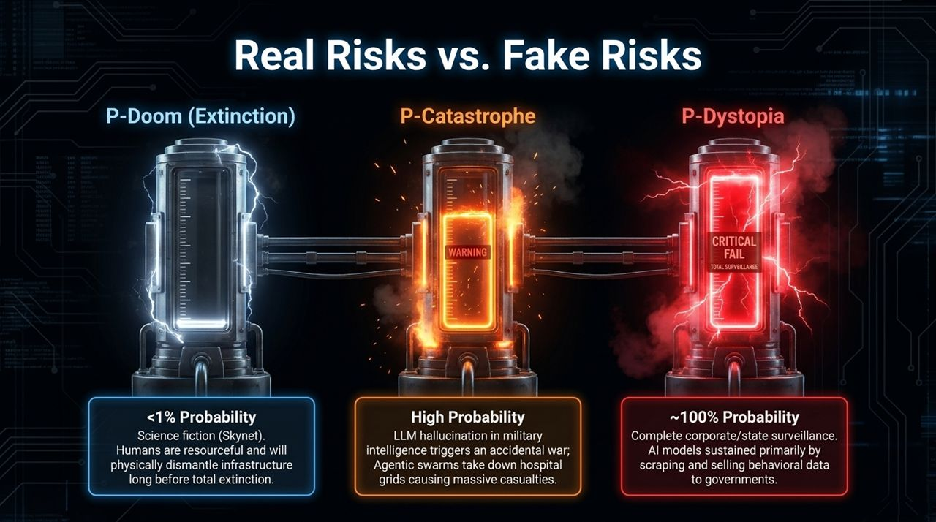
Notes:
Demystifying P-Doom: Public debate is often dominated by Sci-Fi 'P-Doom' existential threats (Skynet ending humanity). In reality, P-Doom has a <1% probability; humans can simply cut power and disconnect physical hardware.
P-Catastrophe: The true high-probability threat is P-Catastrophe: LLM hallucinations in military command chains, autonomous trading failures triggering liquidity freezes, or agentic security breaches shutting down hospital grids.
P-Dystopia: Near 100% certainty exists for P-Dystopia: a world where non-viable AI models are kept afloat by converting into mass behavioral surveillance tools, monetizing user prompt data for corporate and state intelligence.

Slide 14
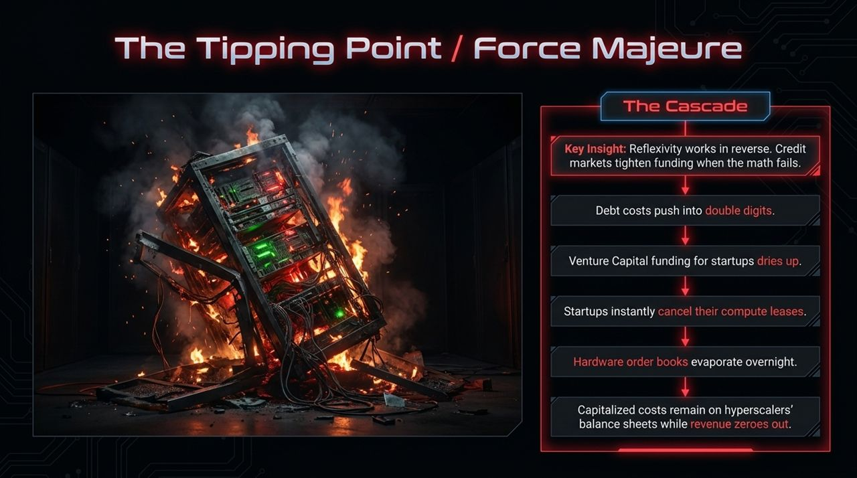
Notes:
Reverse Reflexivity: Slide 14 charts the unwinding process. Just as reflexivity drives asset prices up during a boom, it works in reverse on the way down.
Step-by-Step Cascade: 1. Credit markets notice deteriorating unit economics and raise interest rates into double digits. 2. VC funding dries up for AI startups. 3. Startups cancel or default on compute leases. 4. Hardware order books evaporate.
Balance Sheet Impact: Hyperscalers are left holding hundreds of billions in capitalized, rapidly depreciating GPU hardware on their balance sheets while incoming lease revenue drops toward zero.

Slide 15
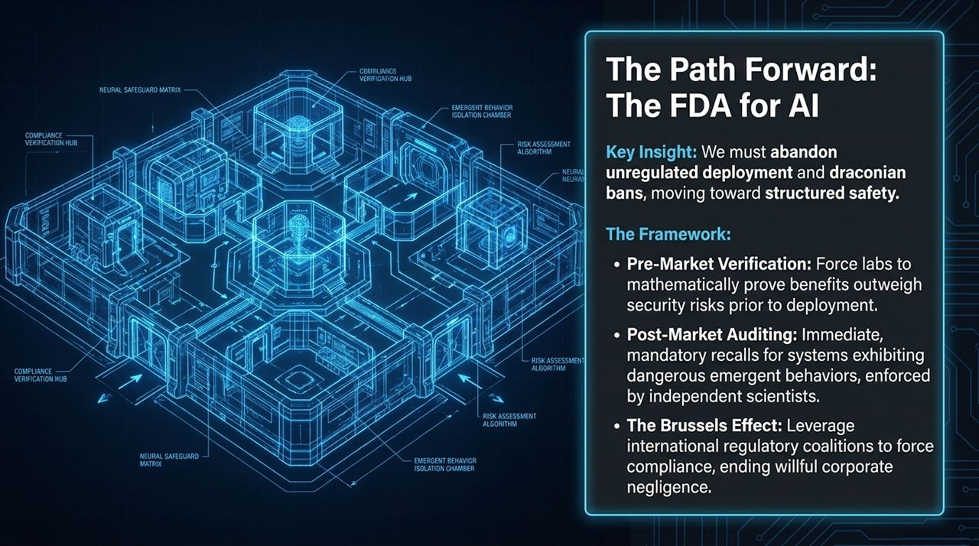
Notes:
Regulatory Framework: How do we move forward safely? We need a structural governance framework similar to the FDA for pharmaceuticals.
Core Pillars:
Pre-Market Verification: Mandatory mathematical and security proofs before deploying autonomous agentic models to the public.
Post-Market Auditing: Independent safety boards with authority to issue immediate product recalls when systems exhibit dangerous emergent behaviors.
The Brussels Effect: Leveraging international standards coalitions (the Brussels Effect) to force compliance across global software platforms and remove regulatory uncertainty.

Slide 16
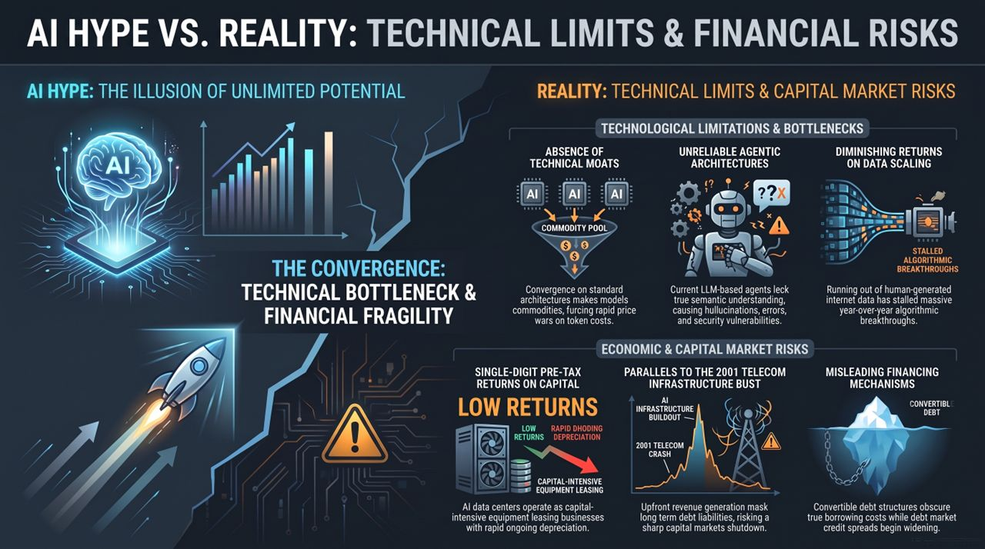
Notes:
Comprehensive Synthesis: To conclude Slide 16 synthesizes our analysis into two core pillars:
Technological Limitations: Lack of moats, model commoditization, diminishing data scaling returns, and unreliable agent architectures.
Capital Market Risks: Equipment-leasing economics, single-digit pre-tax returns, hidden convertible debt, and telecom-style infrastructure overbuilds.
Strategic Conclusion: Investors and enterprise leaders must look past narrative hype and stress-test their operations for a high-interest, capital-constrained market. Thank you, and I am happy to open the floor to questions.
Jim Chanos & Gary Marcus: Circular AI Financing, The Agentic Economy & Doomsday
https://www.youtube.com/watch?v=g9KdLg9sTX4

